Slide 1
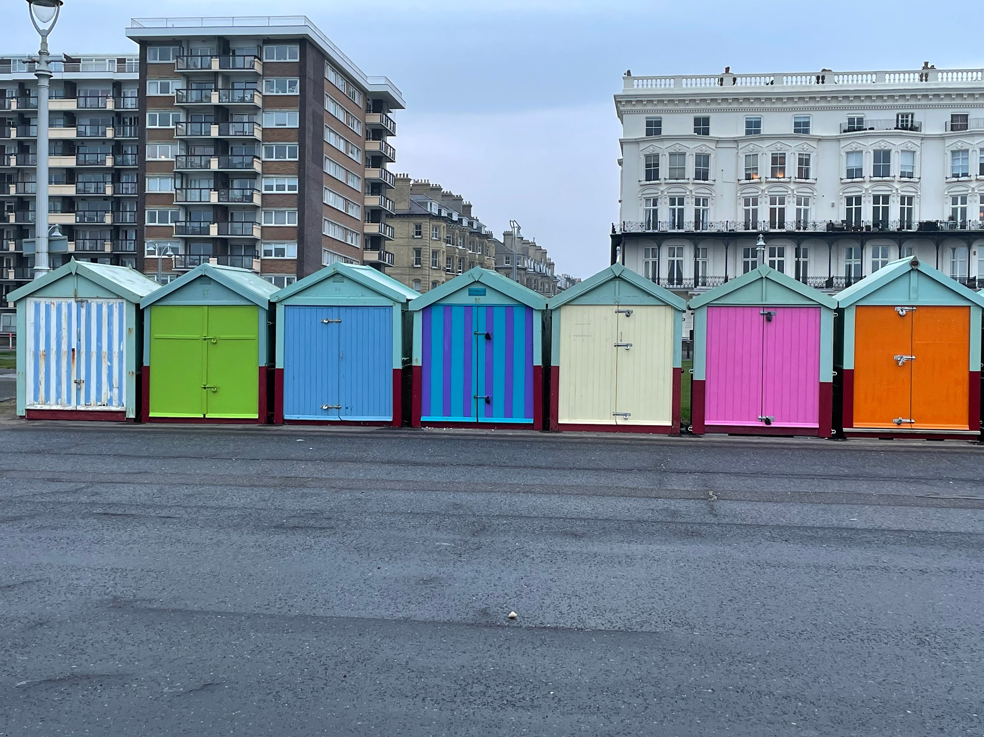
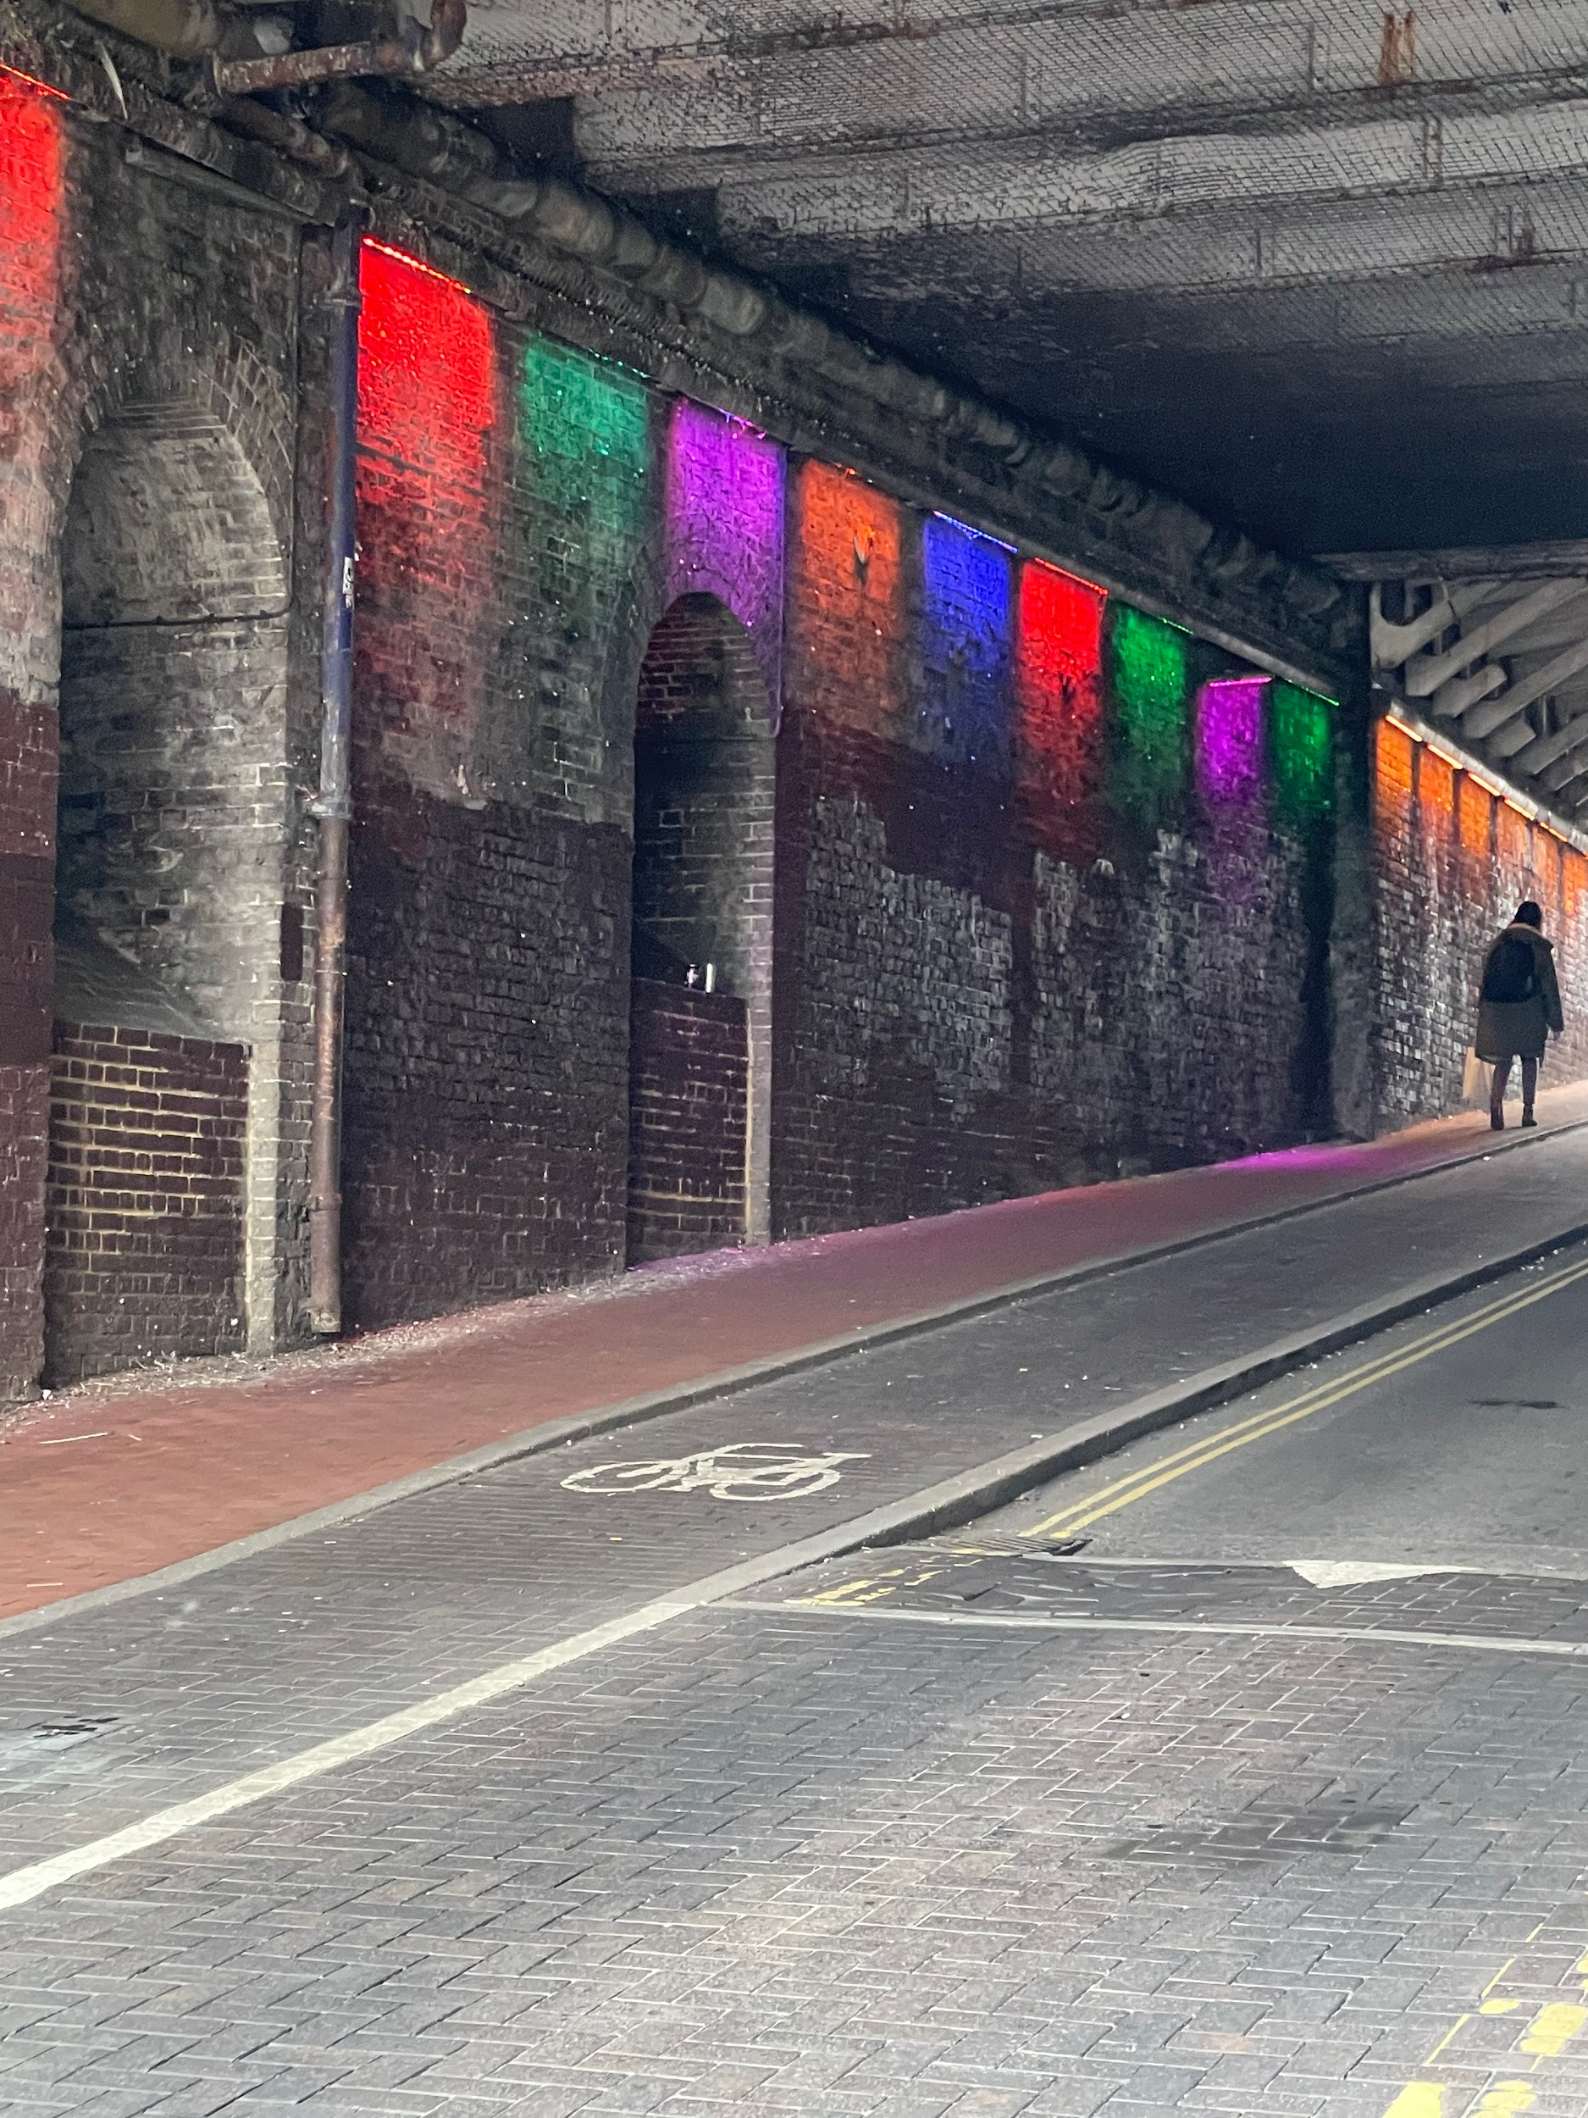
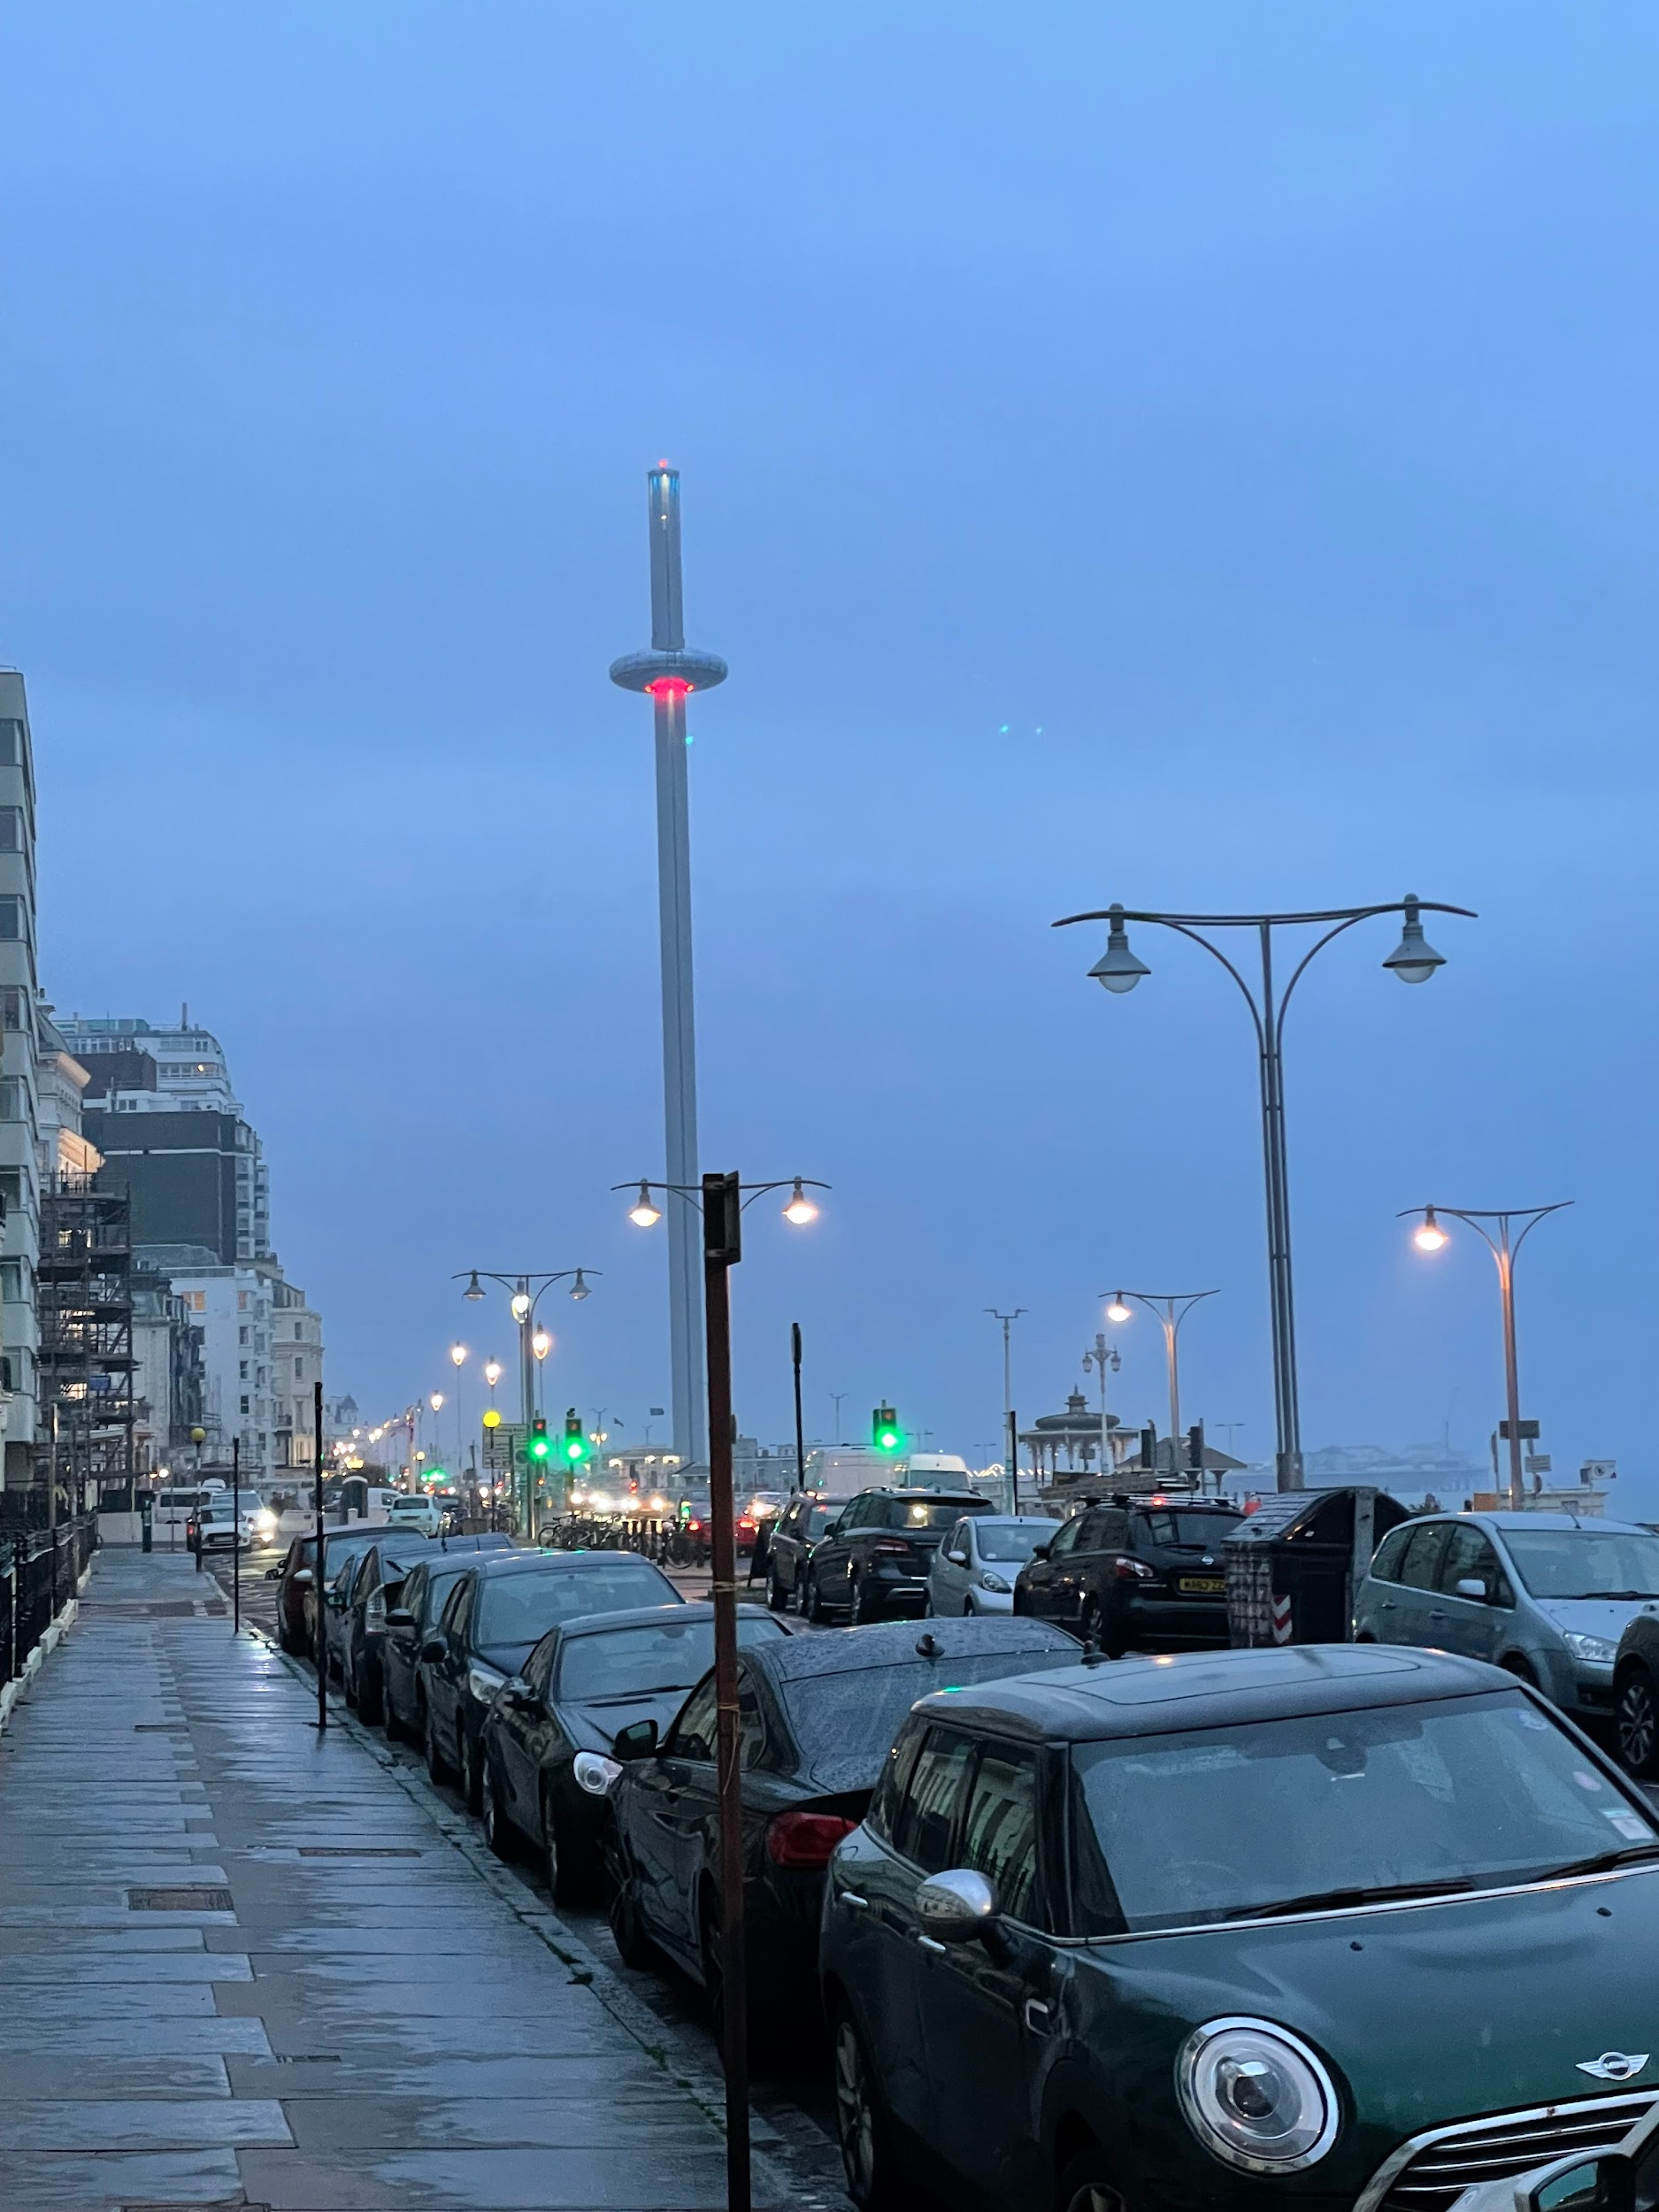
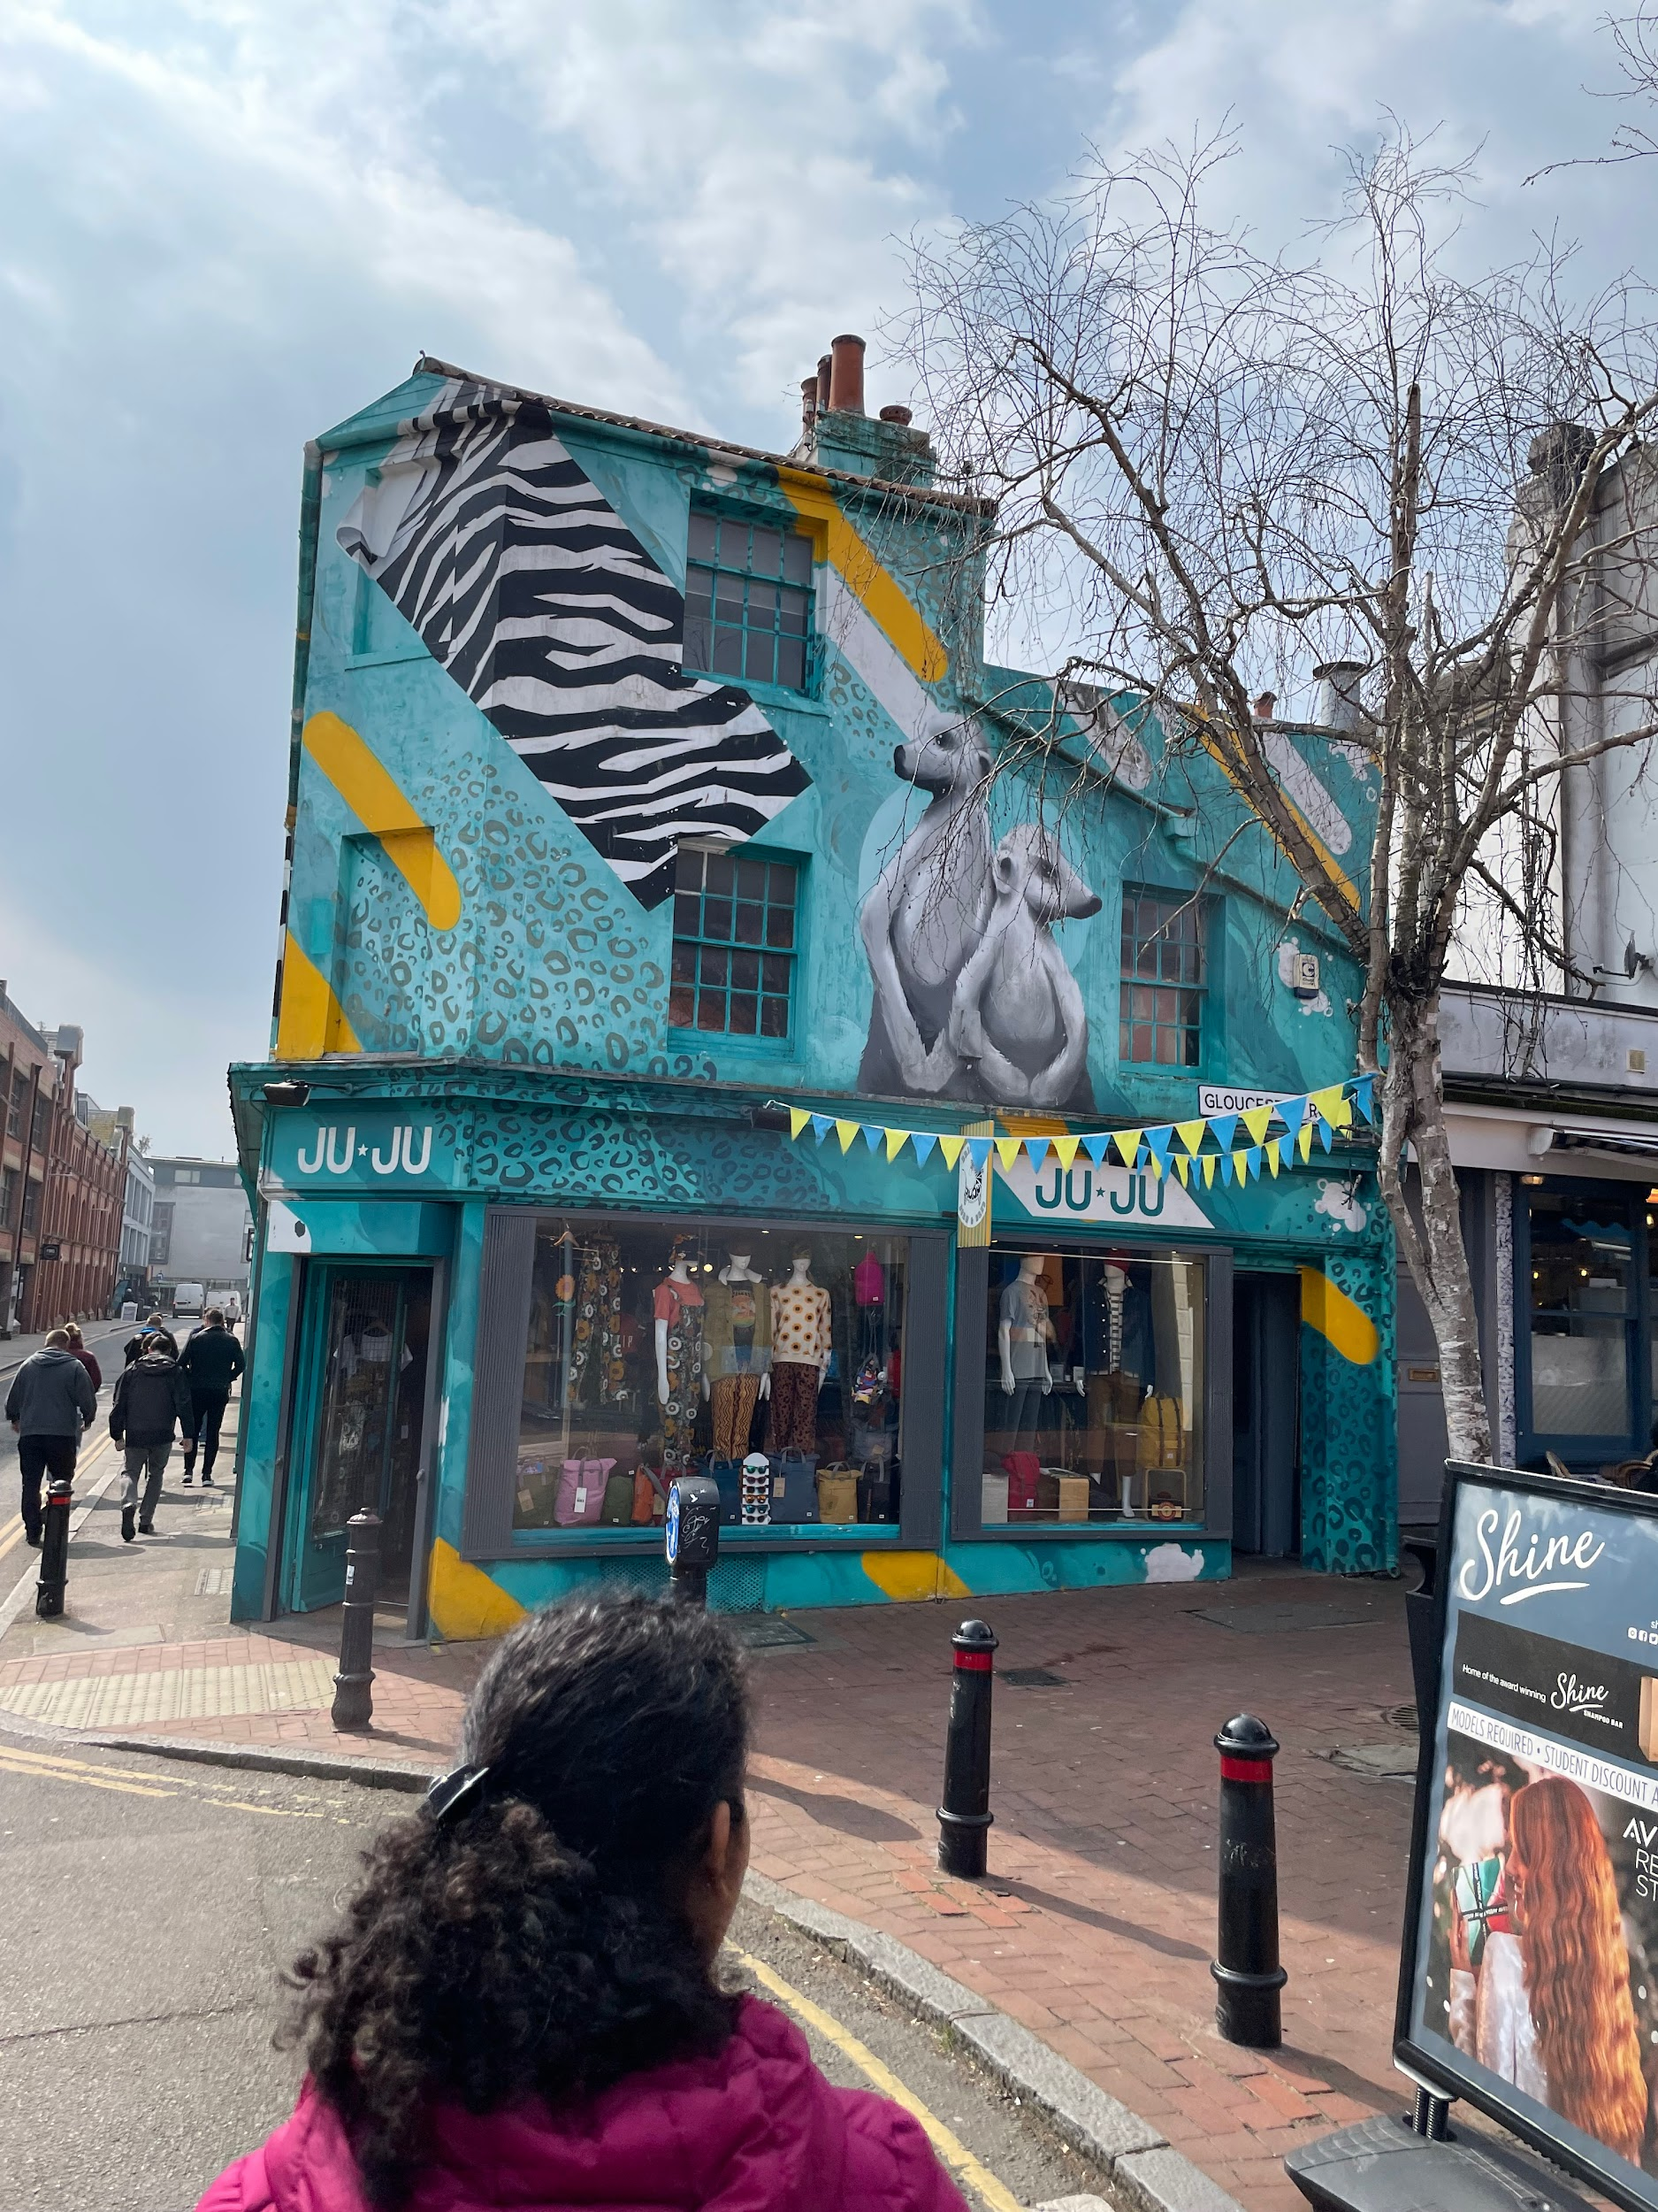
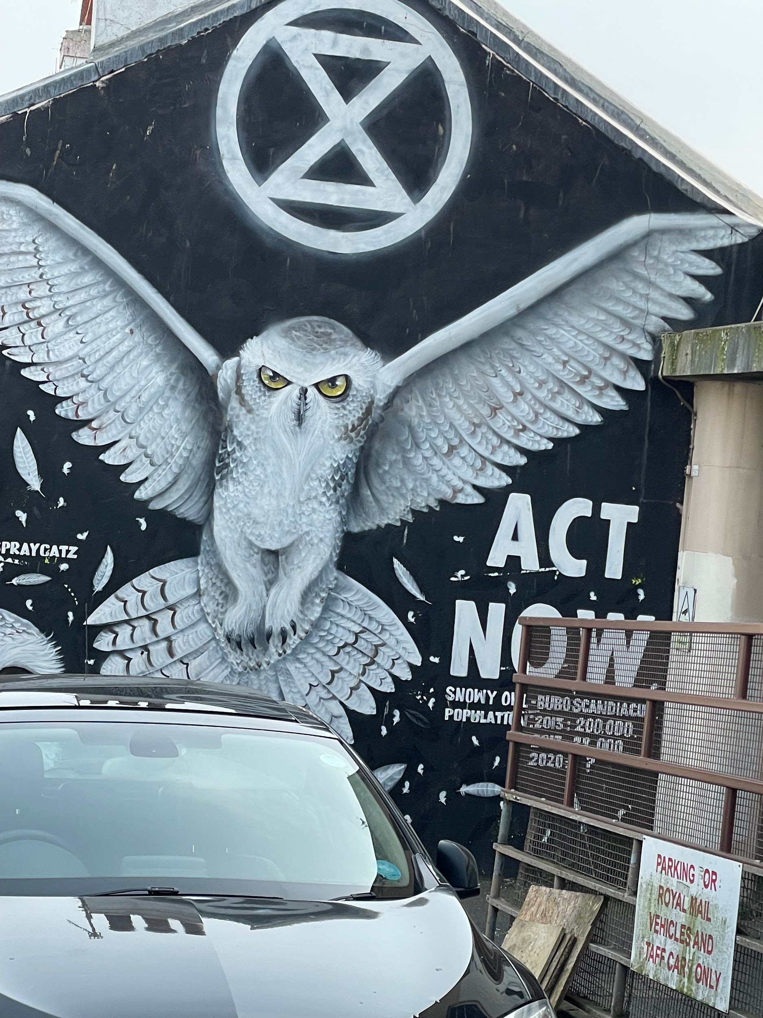
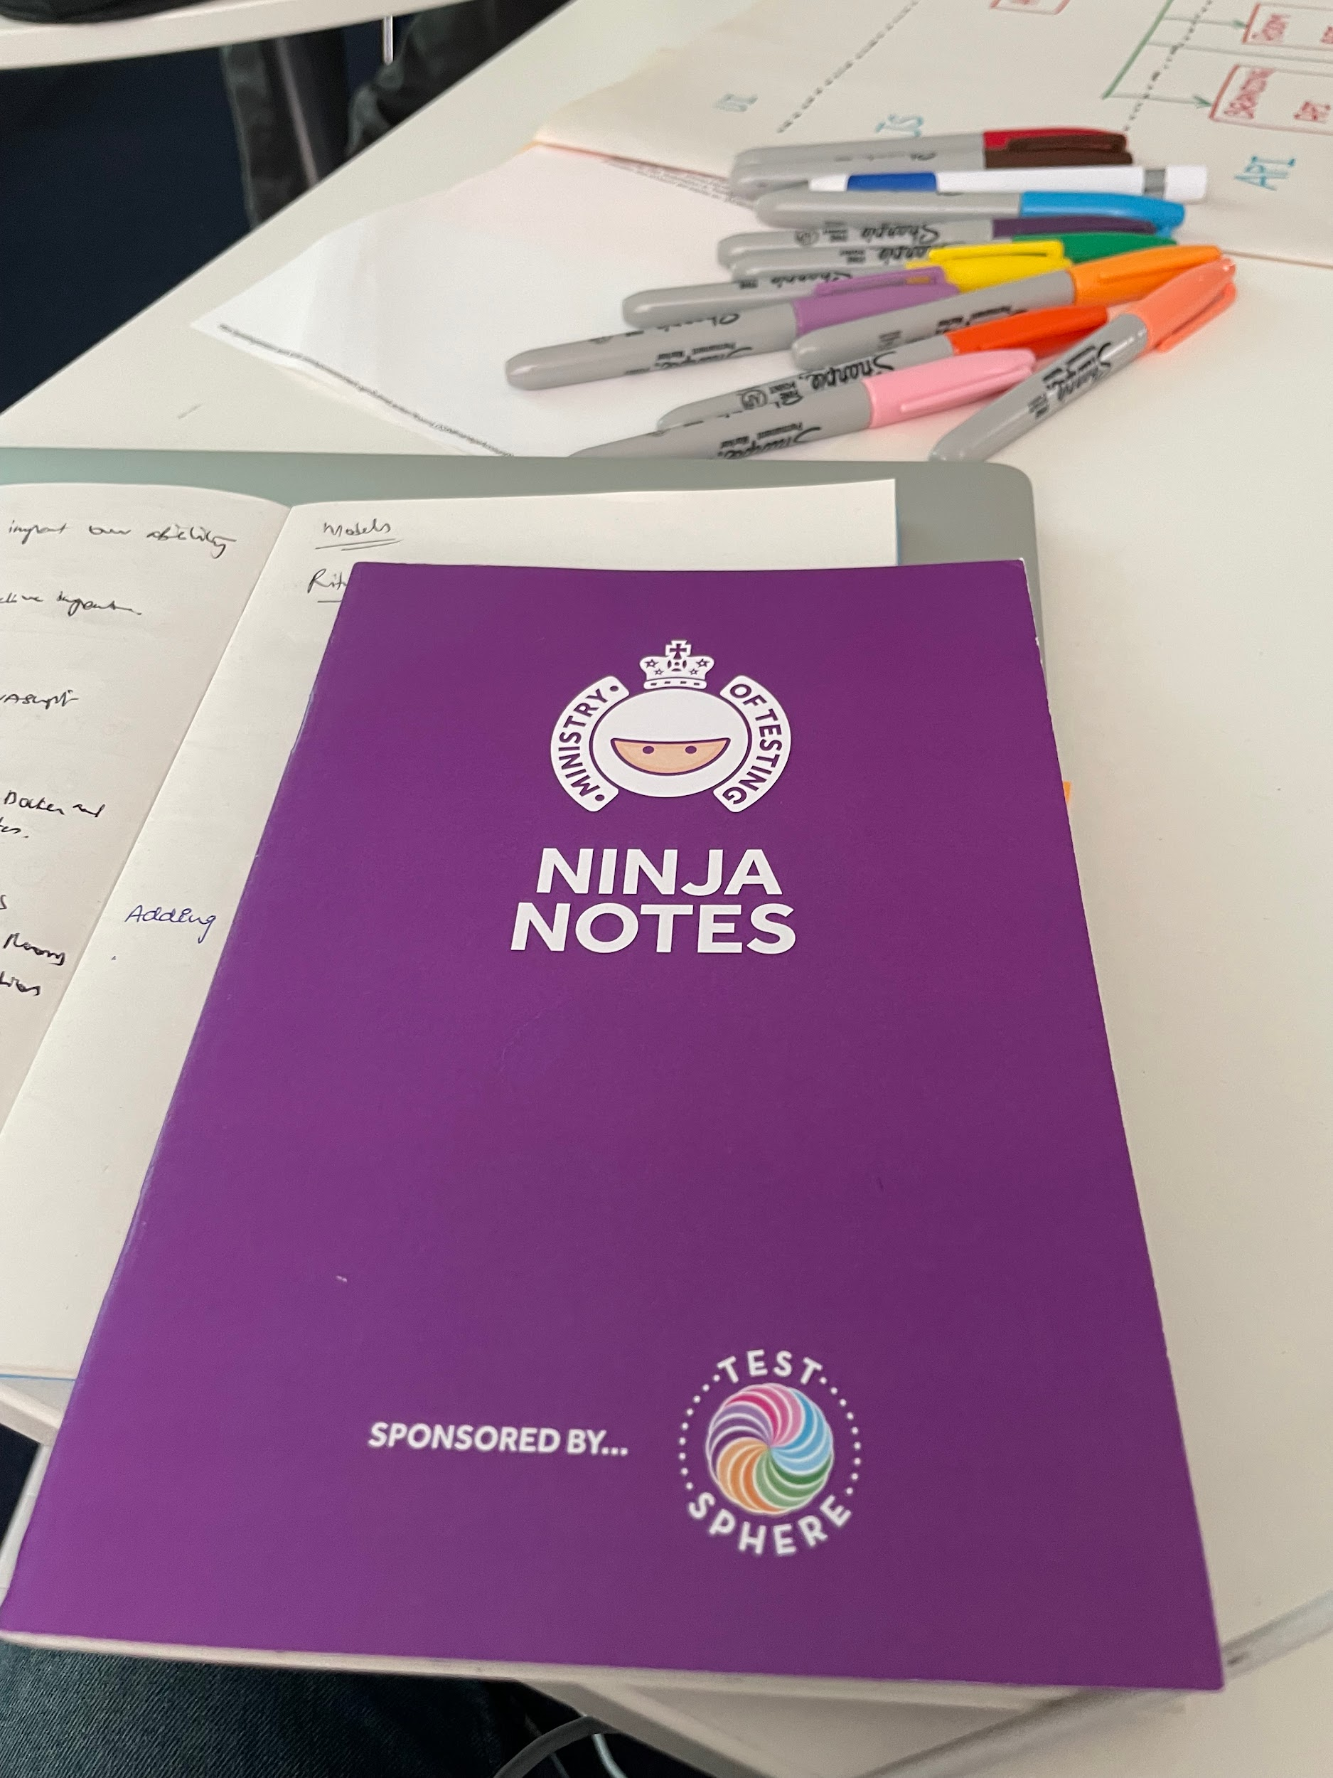
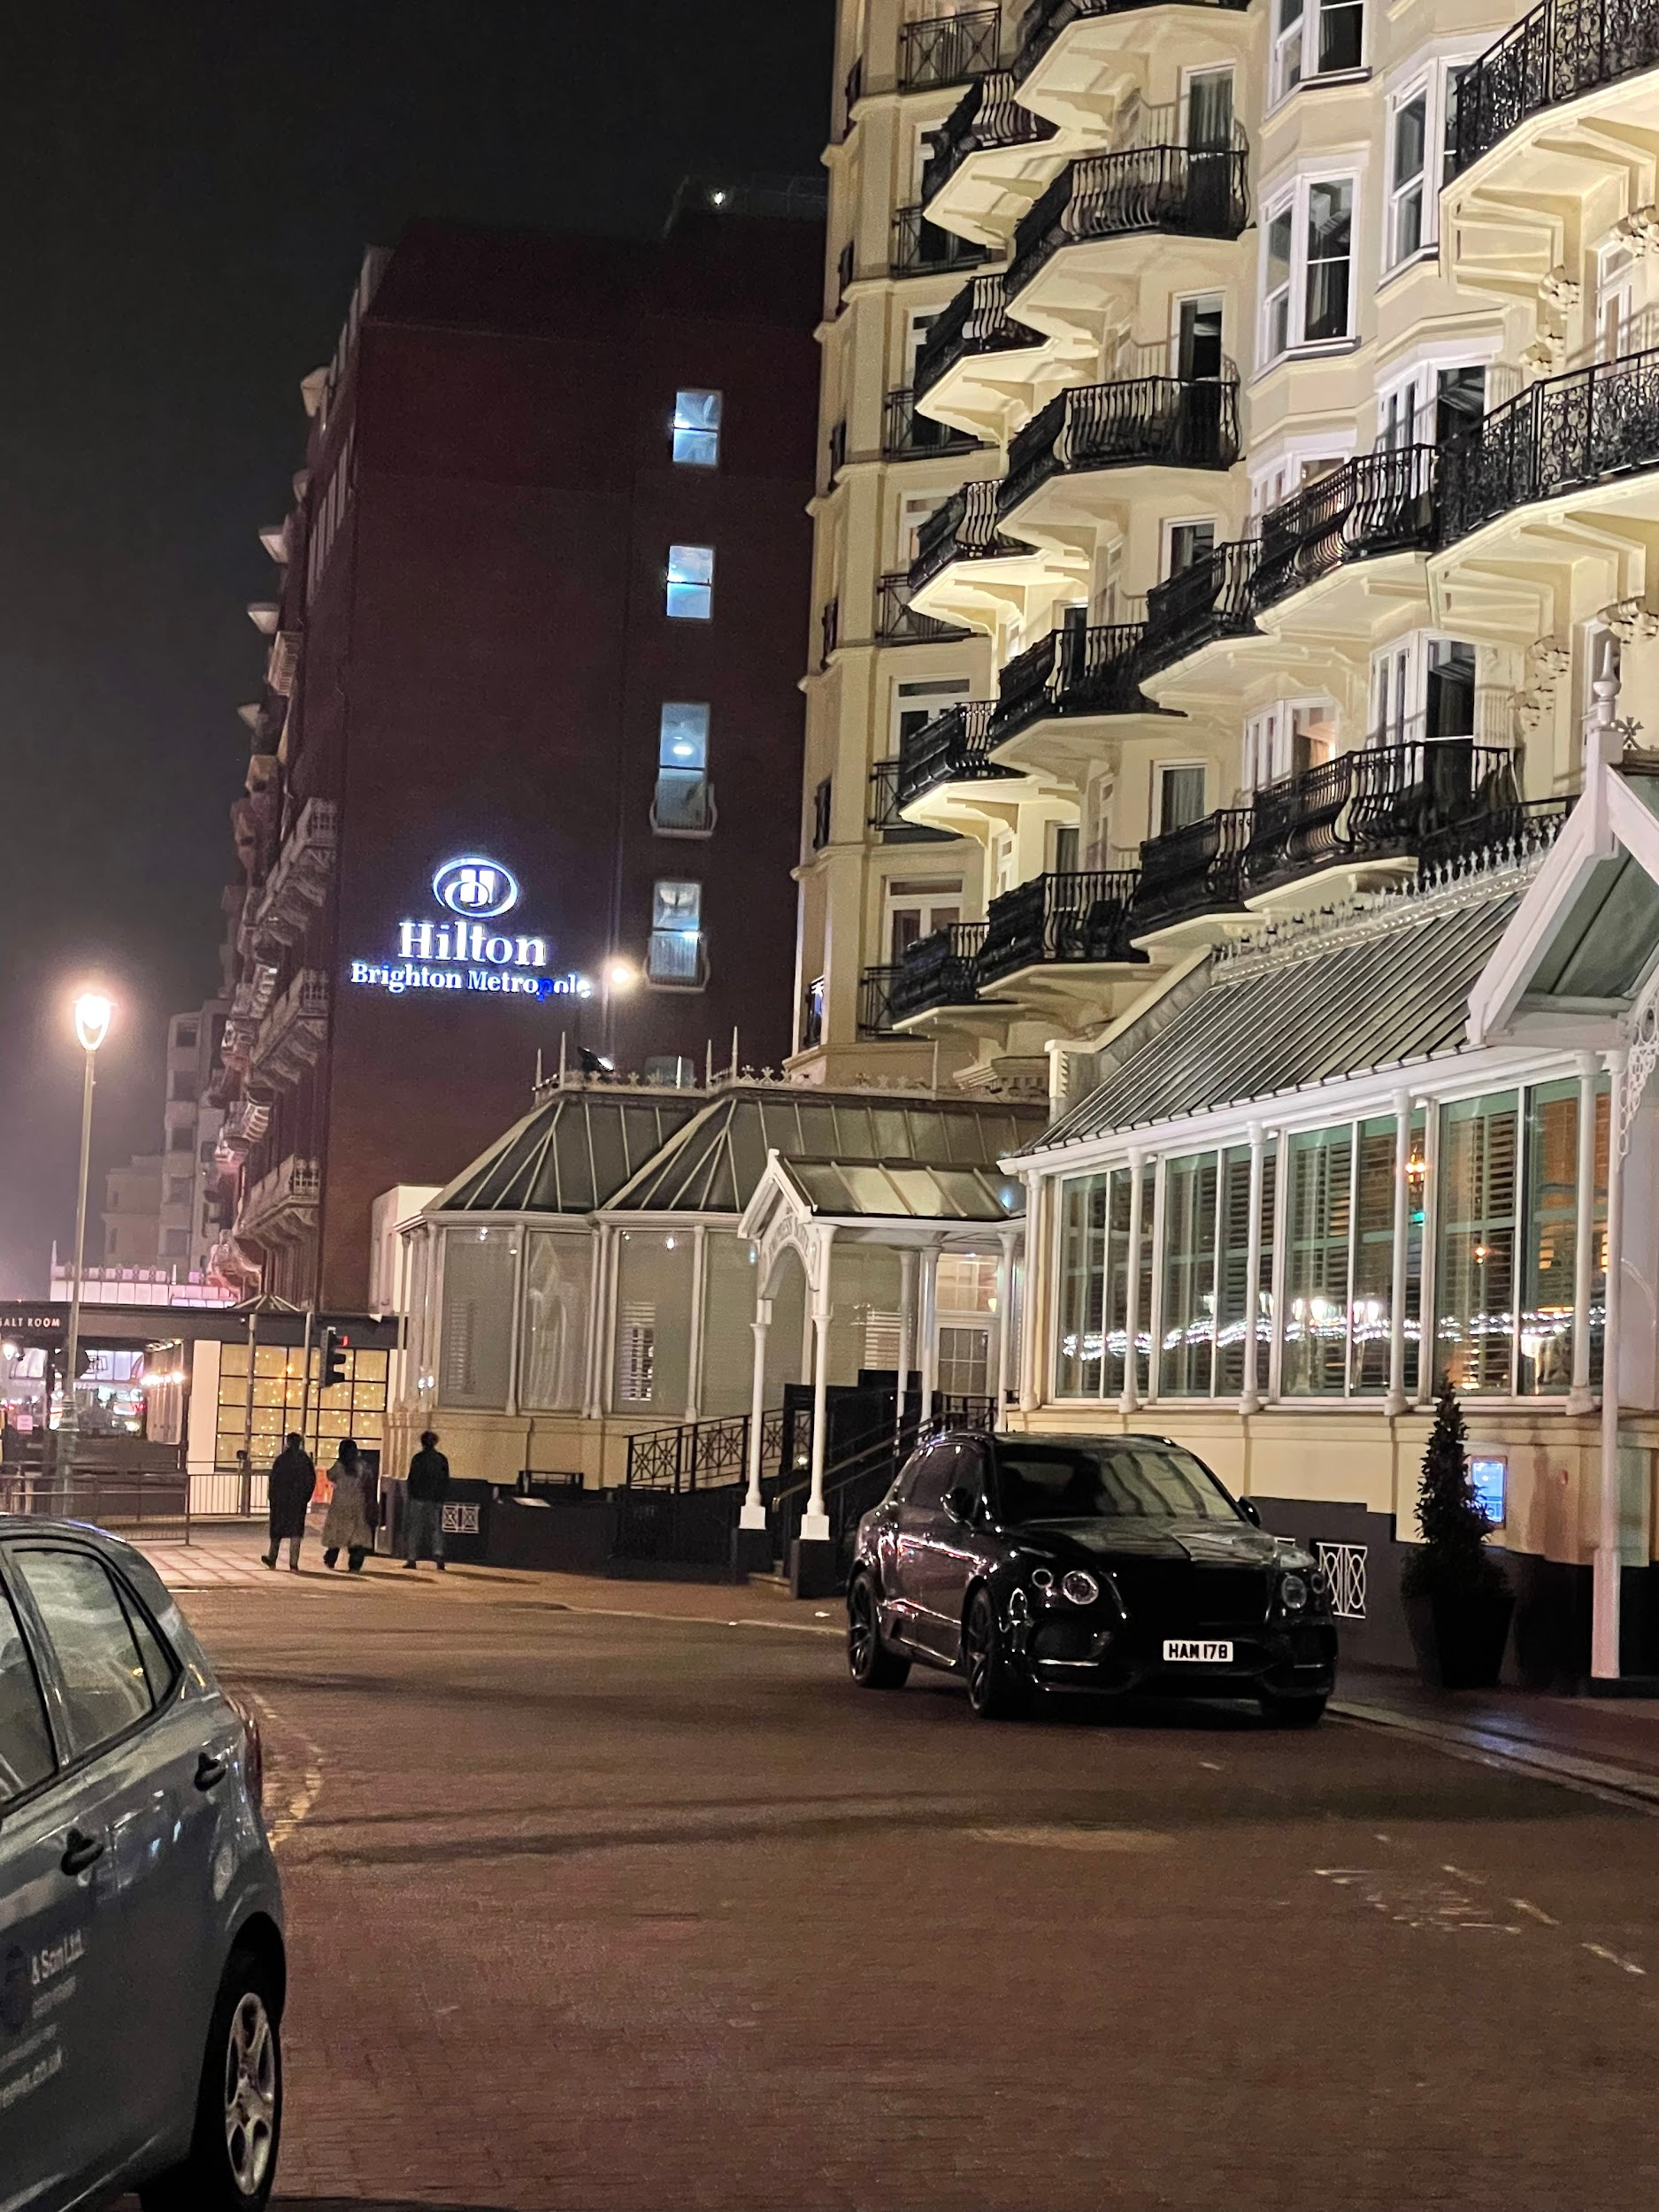
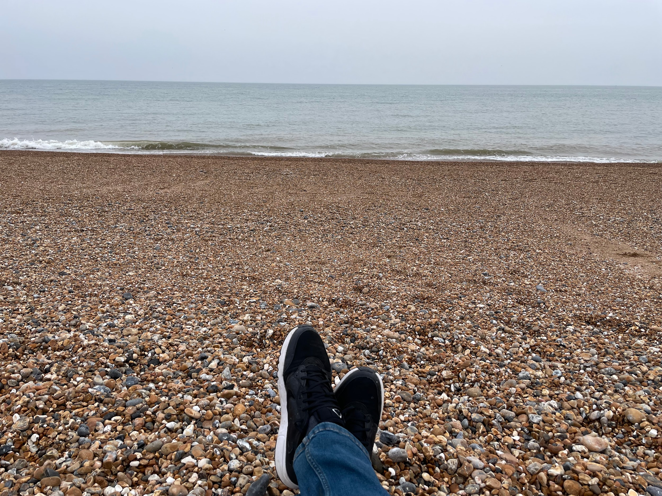
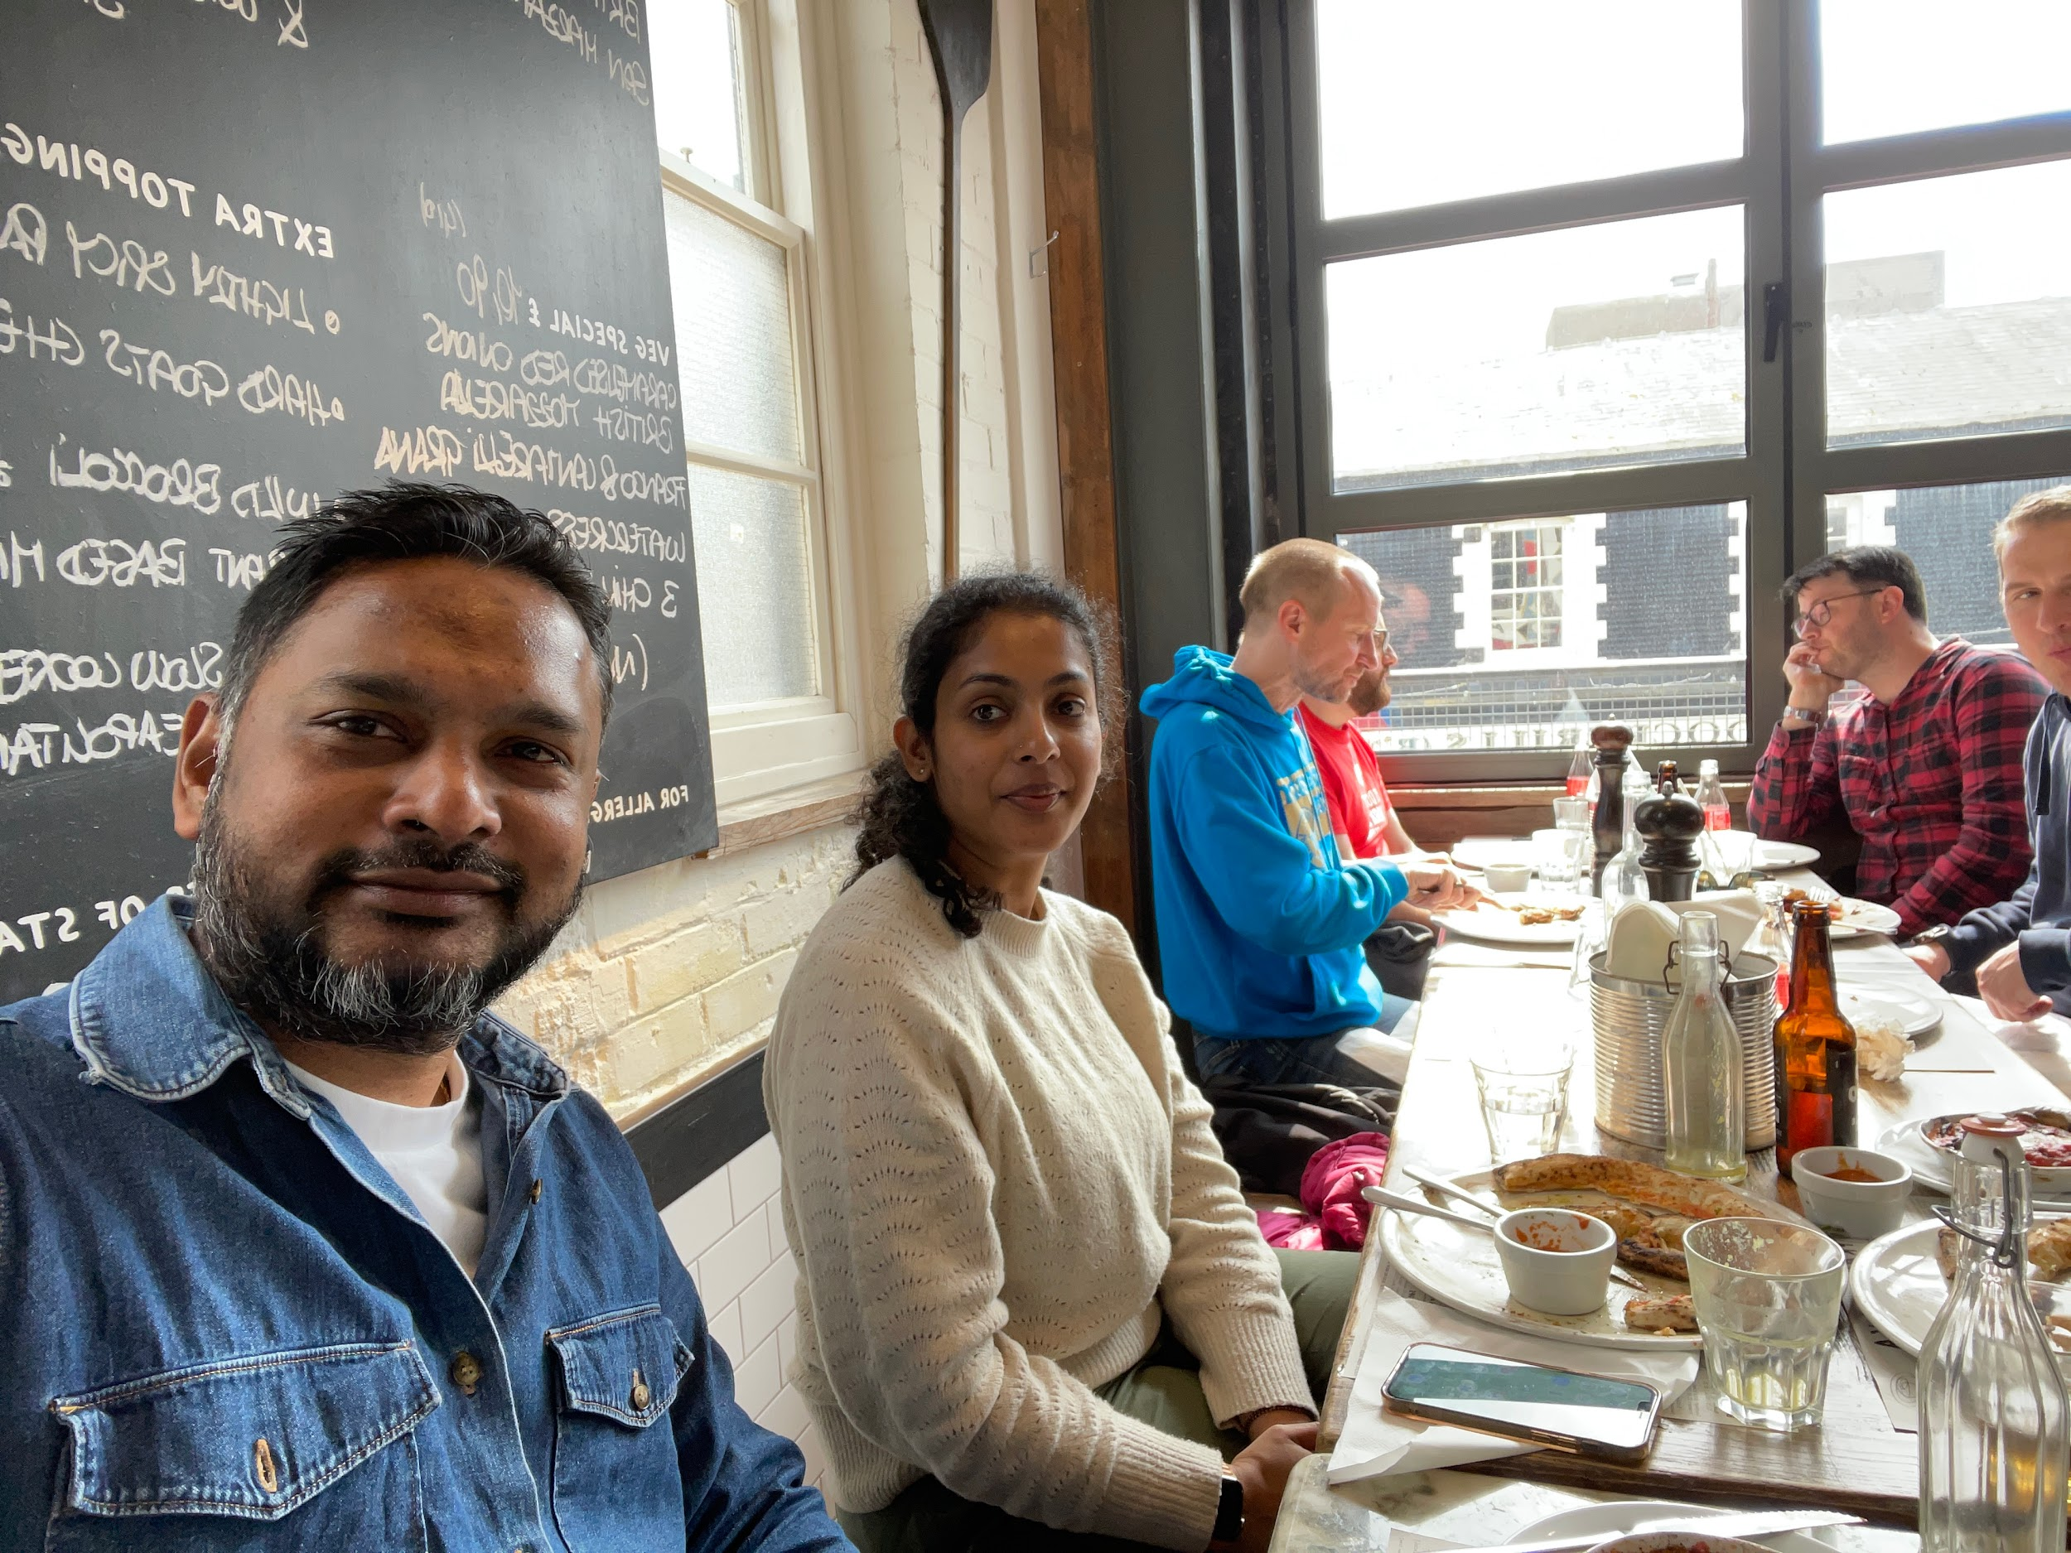
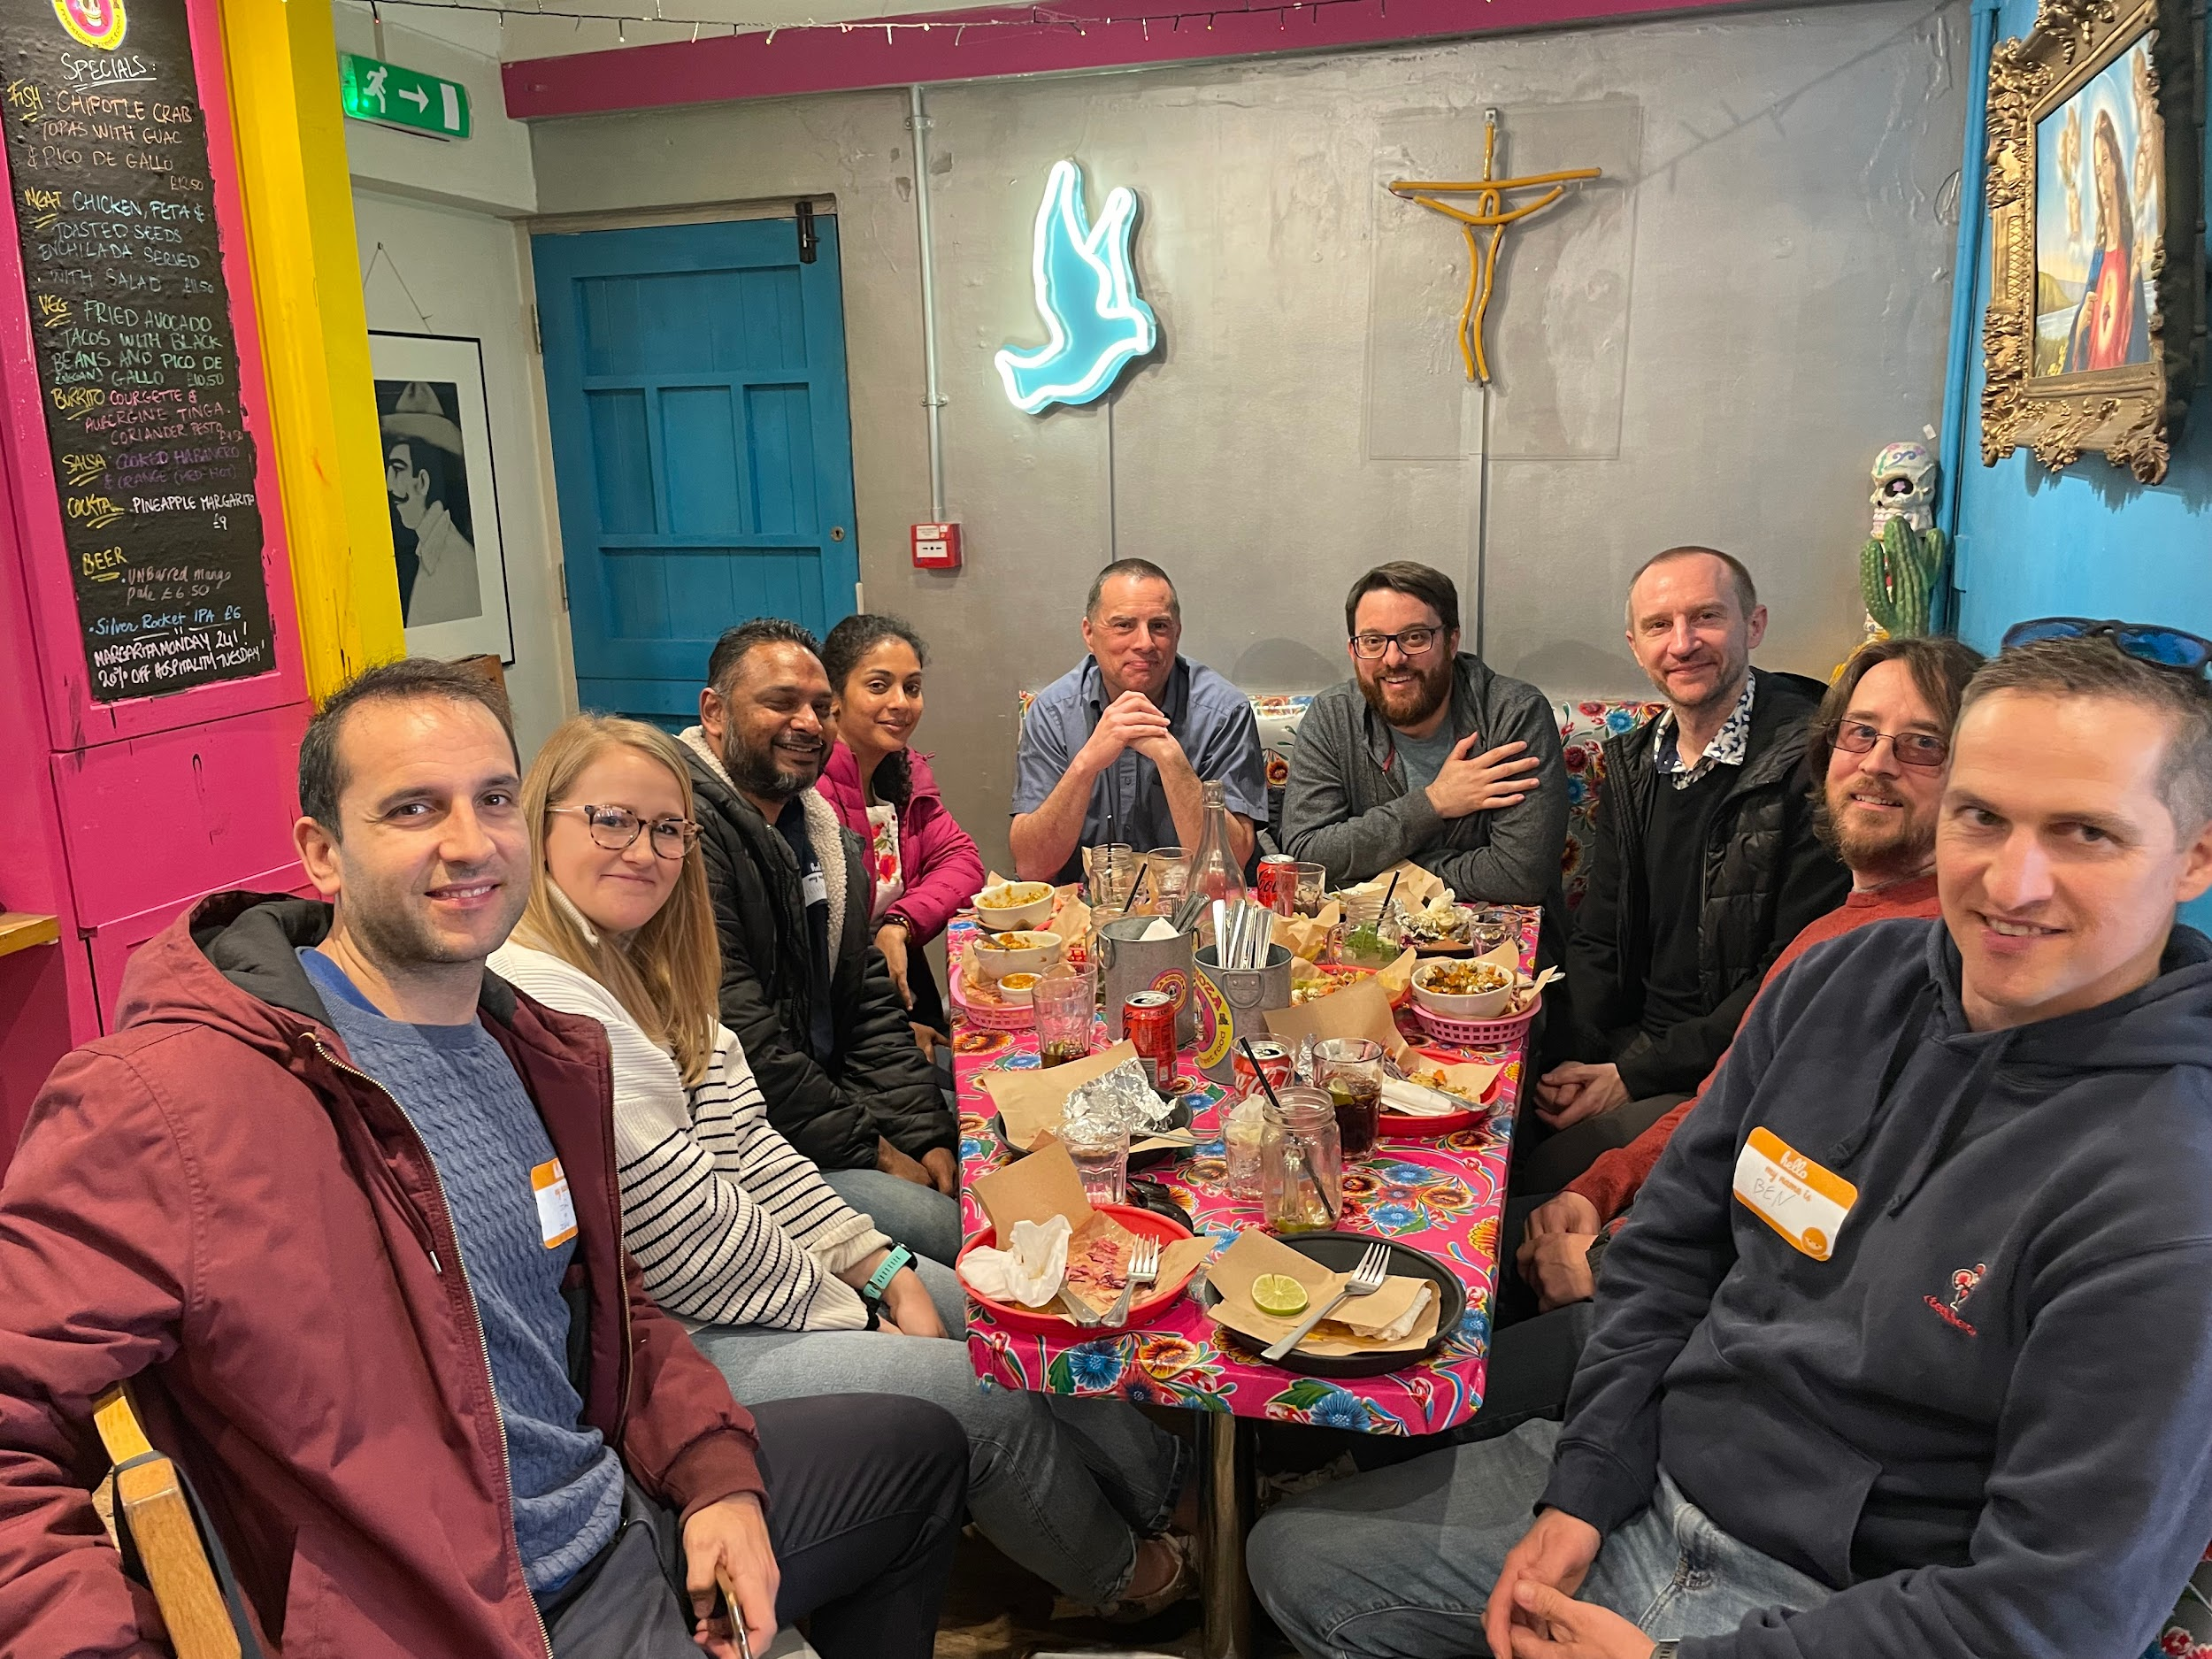
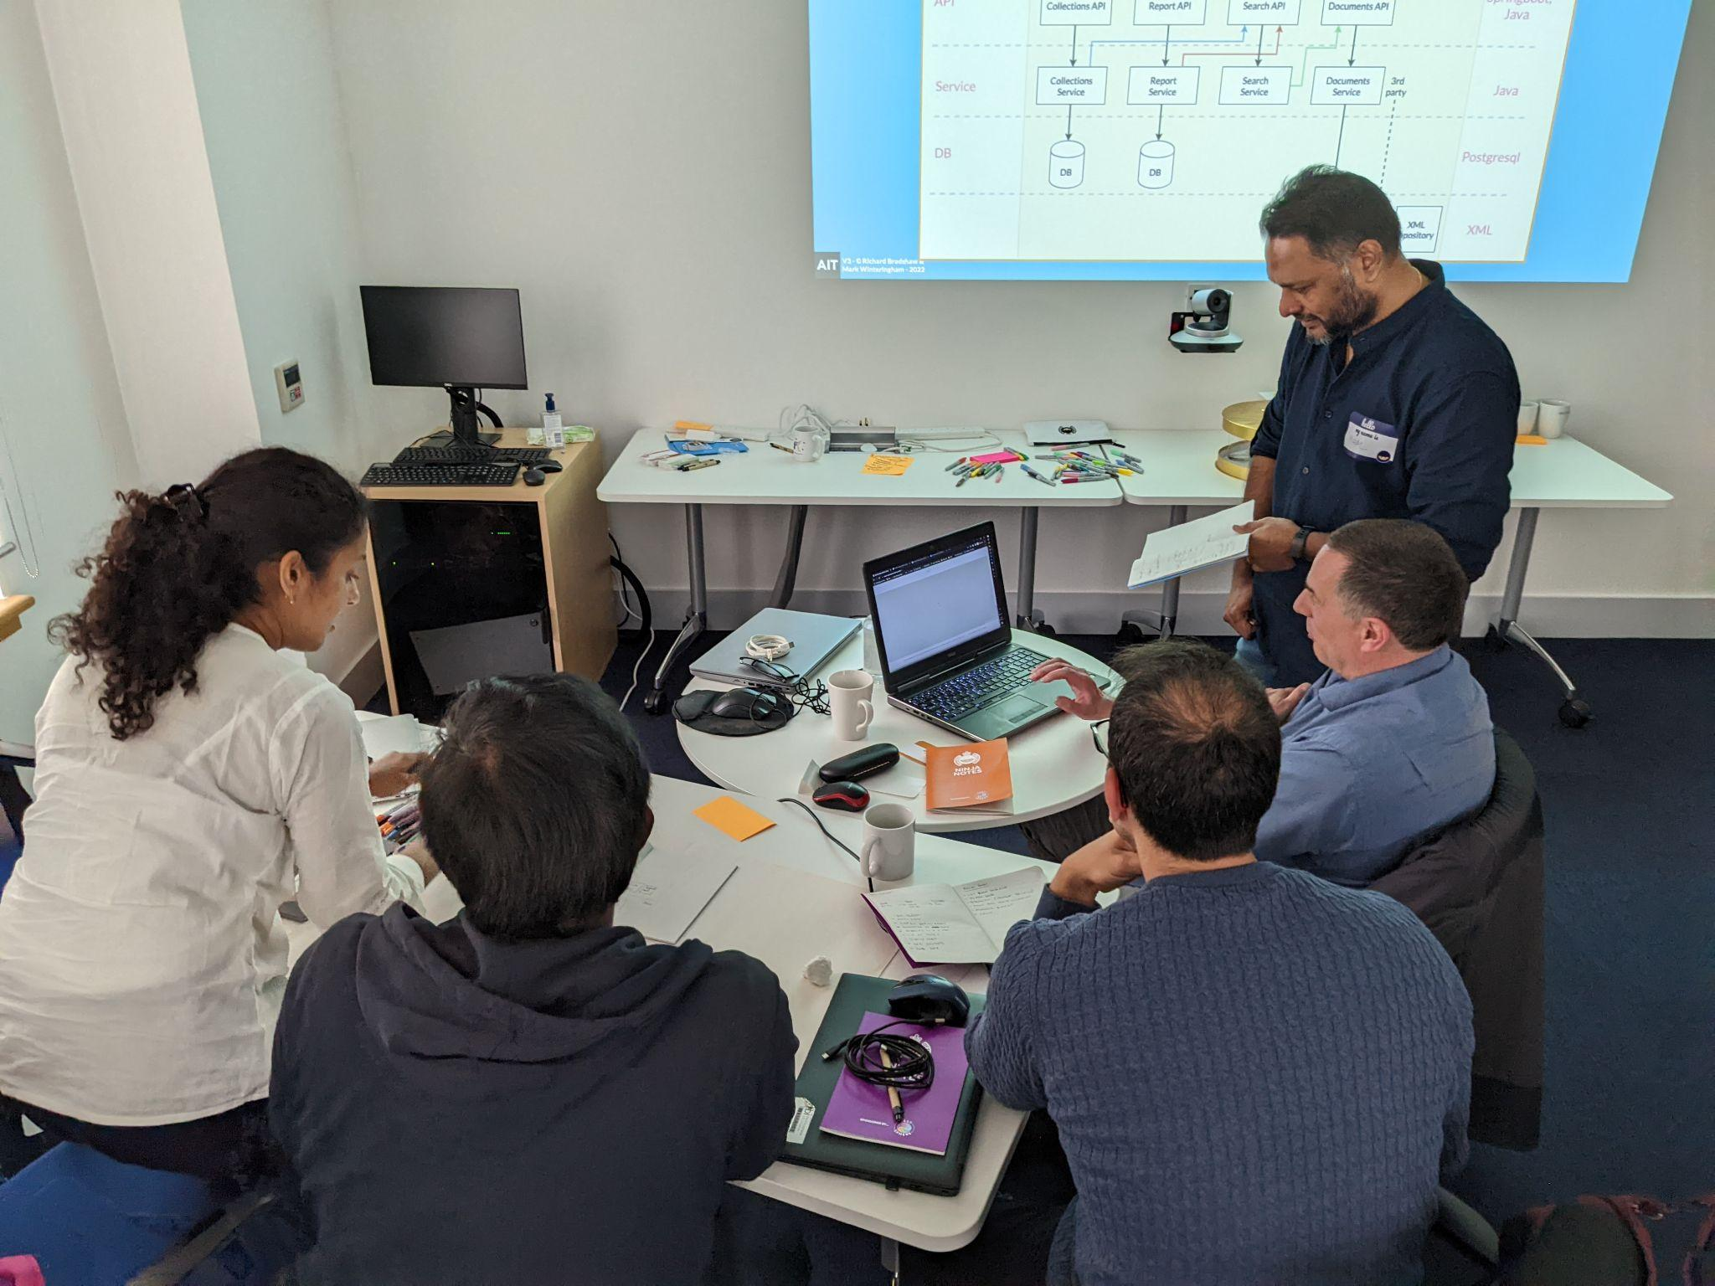
‹#›
My takeaways from…..
Automation in Testing (AiT)
Ministry of Testing (MoT), Brighton

Slide 2

VISUAL TASK ANALYSIS (RISKS)
Deep dive into a specific area of the system.
Building up our internal system knowledge and our technical knowledge.
A vertical slice

Slide 3
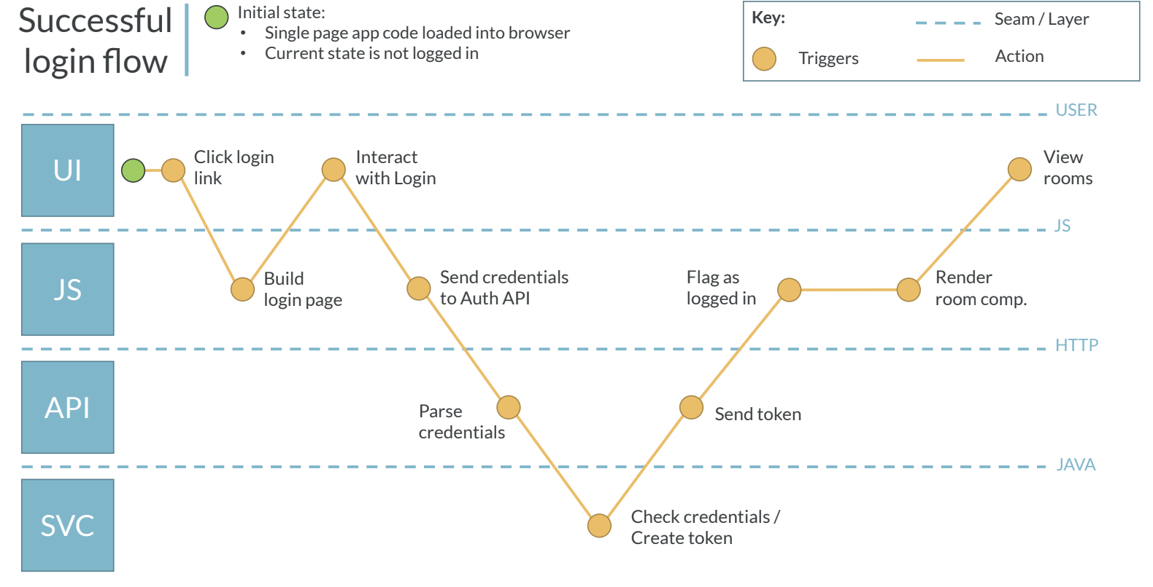
‹#›

Slide 4
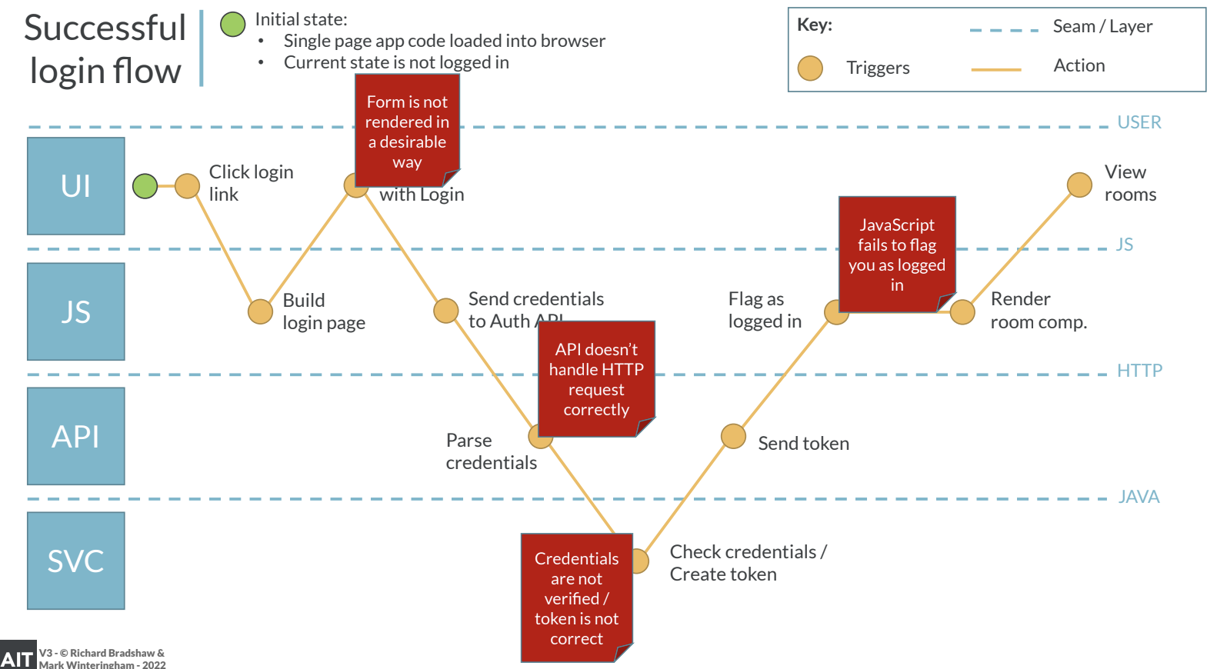
‹#›

Slide 5
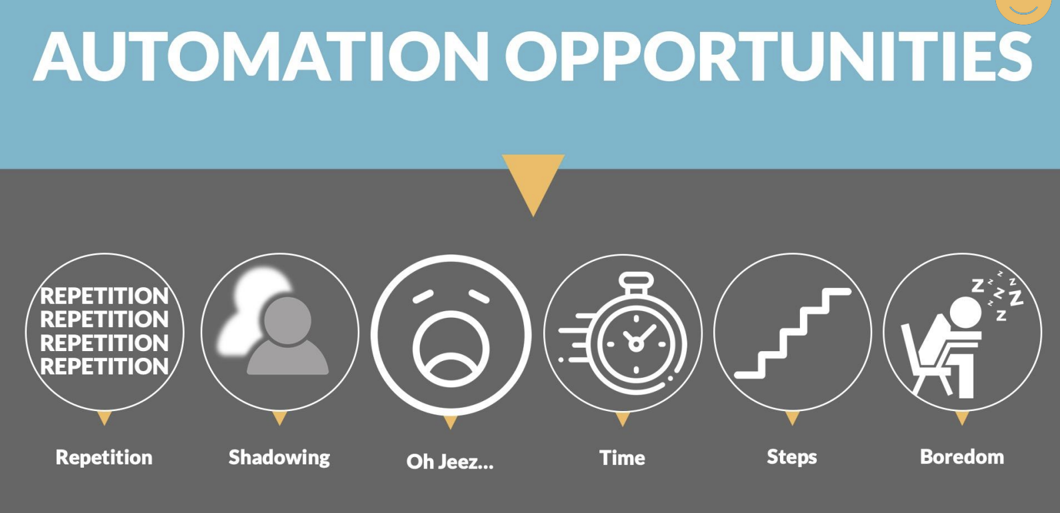

Slide 6
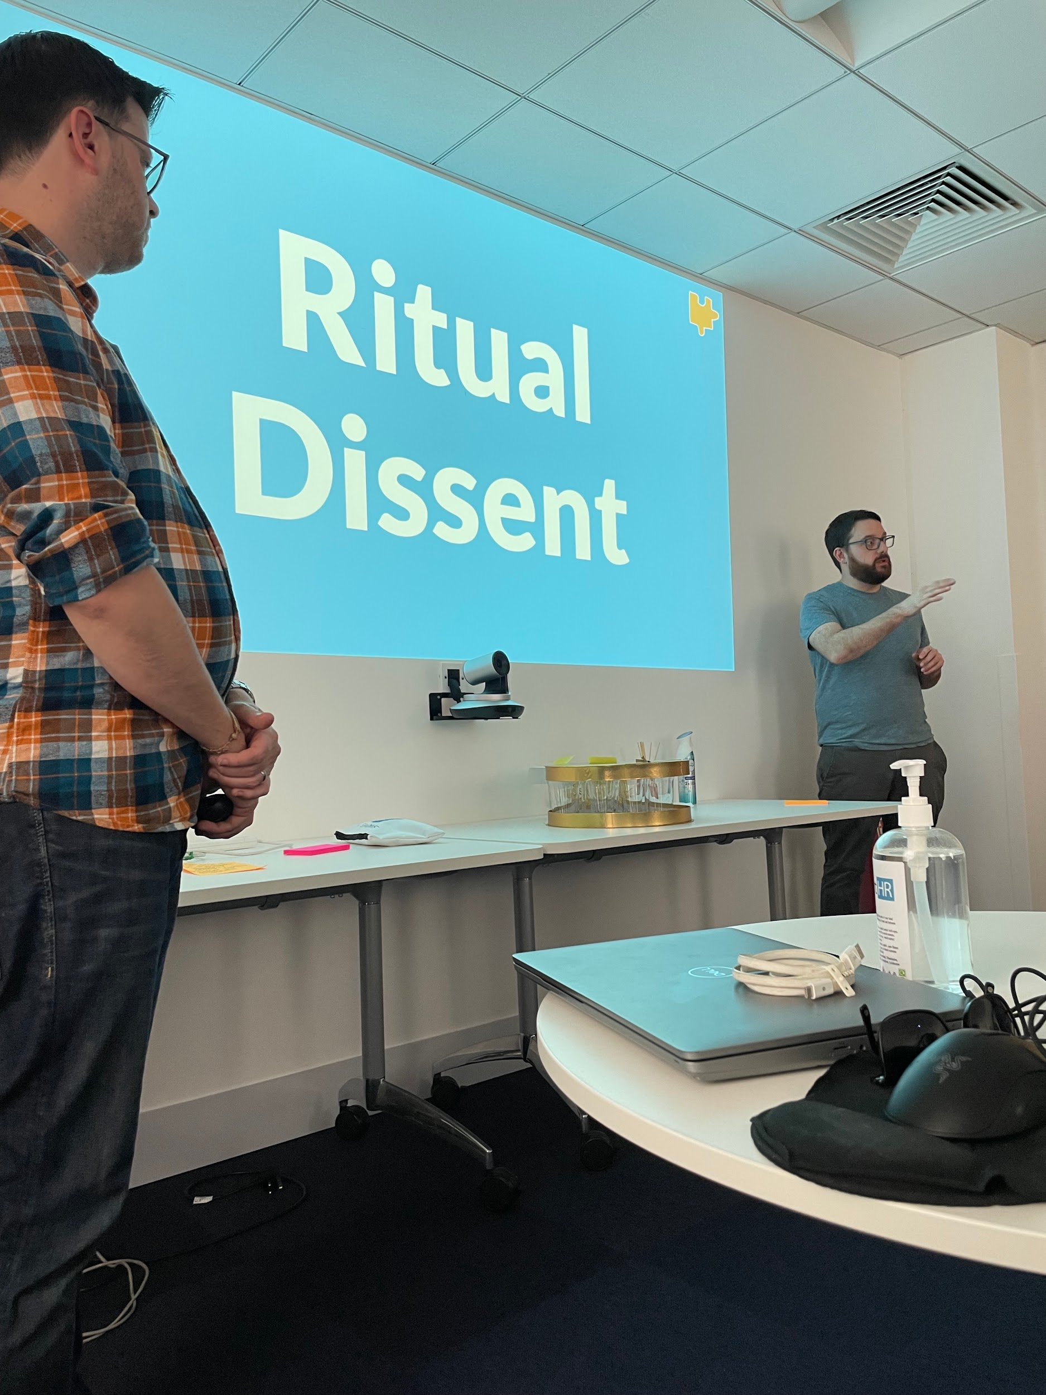
RITUAL DISSENT
Dissent as a strongly held difference of opinion and Ritual as a set of fixed actions that are part of a ceremony, often with deep meaning.

Slide 7
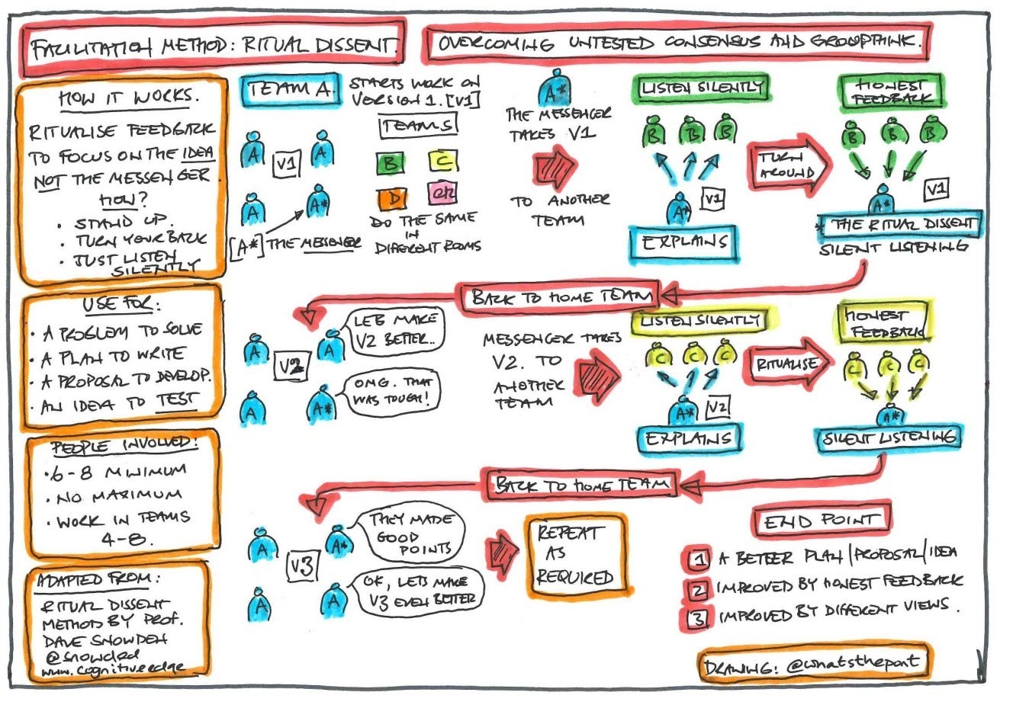

Slide 8
BEING TOOL AWARE
5-10 mins every week on a new tool to be aware of them.

Slide 9
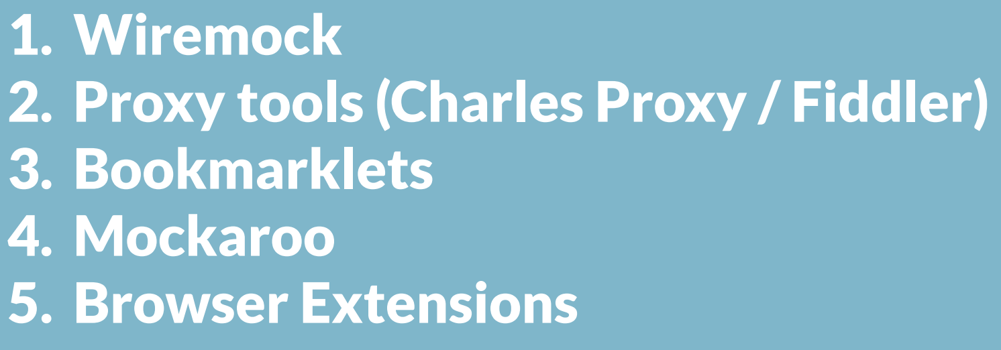
Explore each tool
Make notes of each features and how it can assist your testing
Prepare a short demo to share

Slide 10
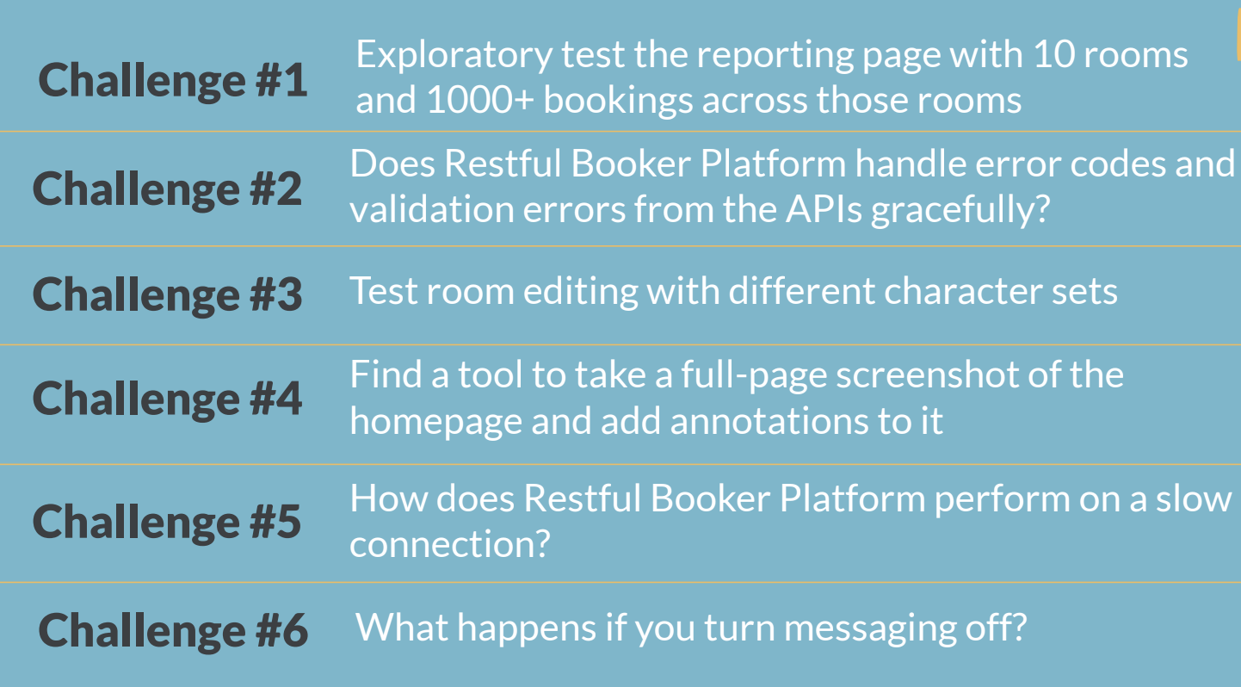
Some tools used to solve the above challenges:
Github naugty strings
PicPick
Lighthouse - Chrome Dev tools
More here: https://automationintesting.com/training/automationintesting/references/index.html

